Slide 1
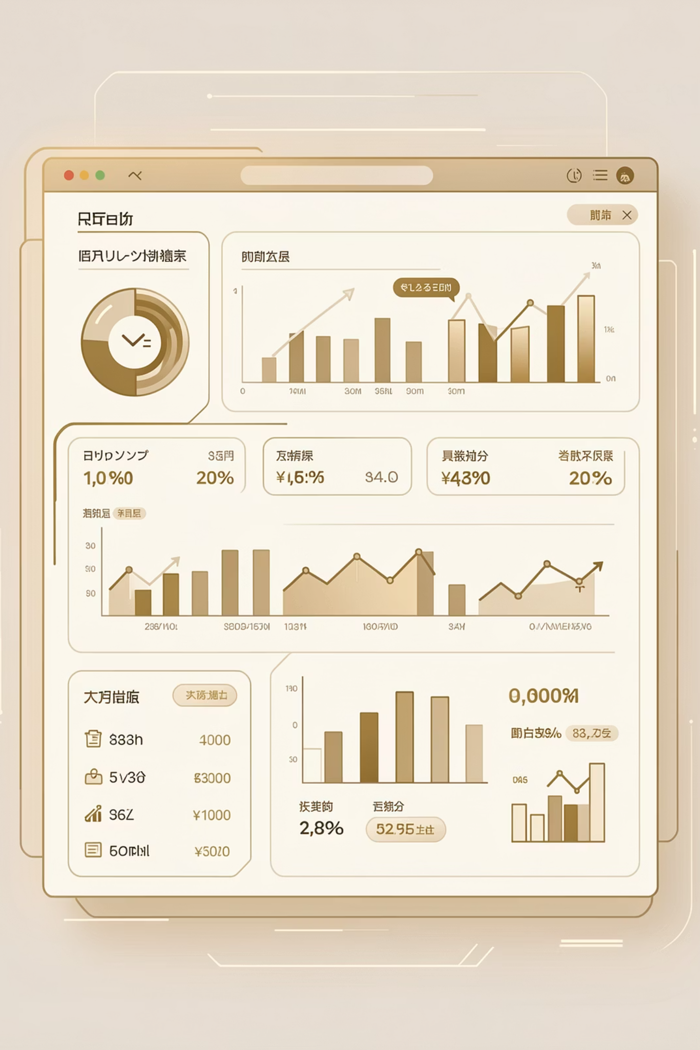
Customer Shopping Behavior Analysis
Unlocking insights from 3,900 purchase records to drive data-driven retail decisions

Slide 2

PROJECT OVERVIEW
Why Analyze Shopping Behavior?
E-commerce Growth
Customer Intelligence
Business Impact
Digital retail generates vast transaction data volumes
Understand preferences, spending habits, purchasing patterns
Optimize marketing, retention, pricing, and revenue
End-to-end analytics workflow: Python → SQL → Power BI

Slide 3
Dataset Overview
3,900
18
37
Purchase Records
Data Columns
Missing Values
Review Rating only
Key Features Captured
Customer demographics: age, gender, location
Purchase details: category, amount, season
Shopping behavior: discounts, reviews, frequency
Shipping preferences and subscription status
Data Quality: No duplicates, well-distributed variables

Slide 4

Data Preparation with Python
01
Data Loading & Exploration
Imported with pandas, analyzed structure and statistics
02
Missing Data Handling
Imputed review ratings using category-level medians
03
Standardization
Converted columns to snake_case for consistency
04
Feature Engineering
Created age groups and purchase frequency metrics

Slide 5
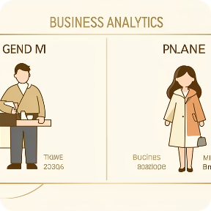




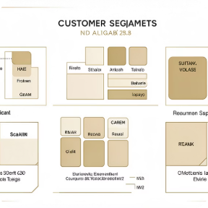
SQL ANALYSIS
Key Business Questions
Revenue by Gender
High-Spending Discount Users
Top-Rated Products
Shipping Type Analysis
Compare spending patterns across demographics
Find products with highest average review ratings
Compare standard vs. express purchase amounts
Identify customers using discounts but spending above average
Subscriber Behavior
Customer Segmentation
Analyze spend differences by subscription status
Classify as New, Returning, or Loyal buyers

Slide 6
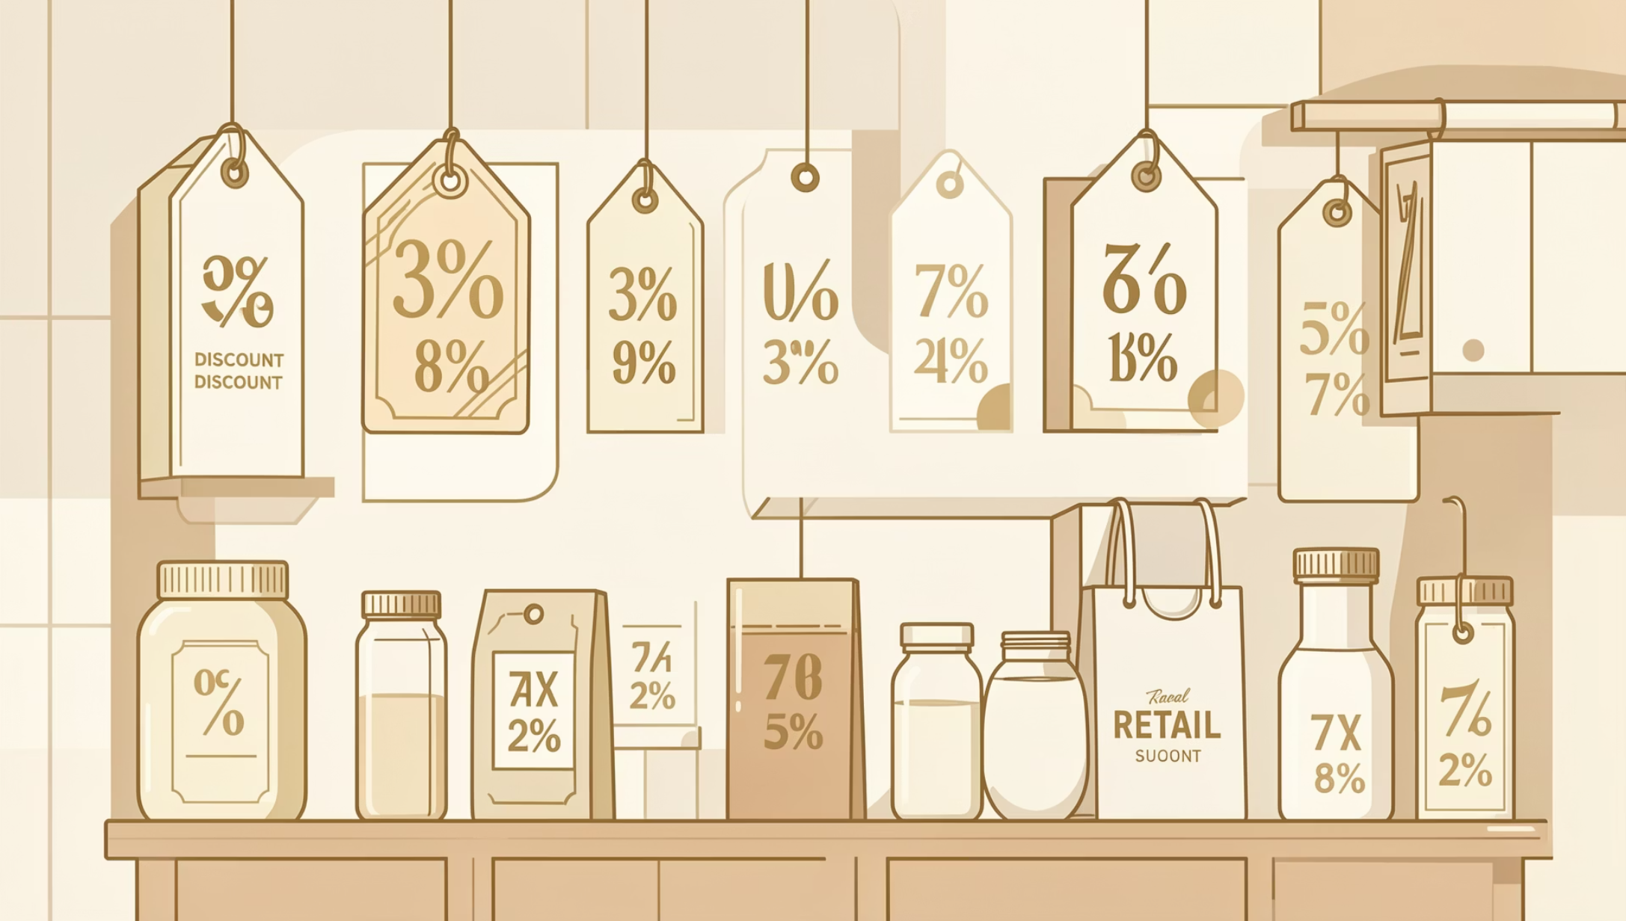

Discount Impact Analysis
Discount-Dependent Products
Top 5 products with highest percentage of discounted purchases reveal pricing sensitivity and promotional effectiveness.
Key Finding: Certain product categories rely heavily on discounts to drive sales volume

Slide 7




Customer Loyalty Insights
New Customers
Returning Customers
Loyal Customers
First-time buyers entering the funnel
2-5 purchases showing engagement
5+ purchases, highest lifetime value
Repeat buyers with 5+ purchases show significantly higher subscription rates
Loyalty programs effectively convert frequent shoppers into subscribers, creating predictable revenue streams.
Loyal (5+)
Returning (2-5)
New (1)

Slide 8
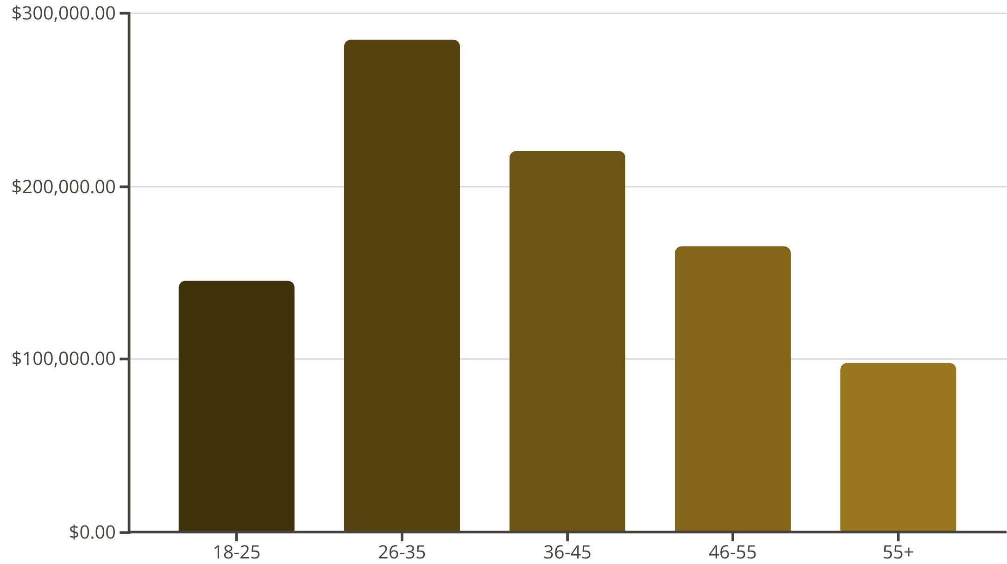
Revenue Distribution Insights
Age Group Performance
Revenue contribution varies significantly across age demographics, revealing key target segments.
26-35 age group: highest revenue contributors
36-45 segment: strong purchasing power
18-25 group: price-sensitive, discount-driven

Slide 9
Power BI Dashboard
Revenue Analytics
Subscription Insights
Product Performance
Discount Impact
Promotional effectiveness and margin analysis
Gender, age group, and category breakdowns
Subscriber vs. non-subscriber spending comparison
Category rankings and top-rated items
Customer Segments
Shipping Analysis
New, Returning, and Loyal buyer overview
Standard vs. Express purchase patterns

Slide 10
Strategic Recommendations
Boost Subscriptions
Loyalty Programs
Optimize Discounts
Promote exclusive benefits to convert high-frequency buyers
Reward repeat buyers to accelerate movement into Loyal segment
Balance promotional sales boosts with margin control
Product Positioning
Targeted Marketing
Highlight top-rated and best-selling items in campaigns
Focus on high-revenue age groups (26-45) and express shipping users

